Slide 1
General viva Presentation
computer and communication engineering

Slide 2
Submitted By:
Zia Ul Hassan Chowdhury

Slide 3


Understanding Network Topology

Slide 4
CONTENTS
Network Topologies
Types of Network Topologies

Slide 5
What is Network Topology?
Network topology describes the arrangement of nodes, devices, and connections in a computer network, defining how data flows and how devices communicate.

Slide 6
Types of Network Topology
Bus Topology
Star Topology
Ring Topology
Tree Topology
Mesh Topology
Hybrid Topology

Slide 7
Bus Topology
In this topology there is a central connection line where all the nodes or computer and other devices are connected. This central line is known as the Bus.
Fig1: Bus Topology

Slide 8
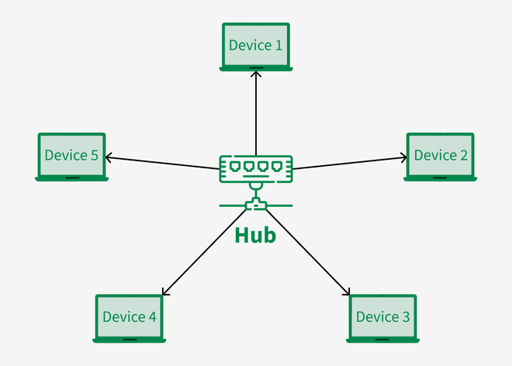
Star Topology
In Star Topology, all the devices are connected to a single hub through a cable. This hub is the central node and all other nodes are connected to the central node.
Fig2: Star Topology

Slide 9
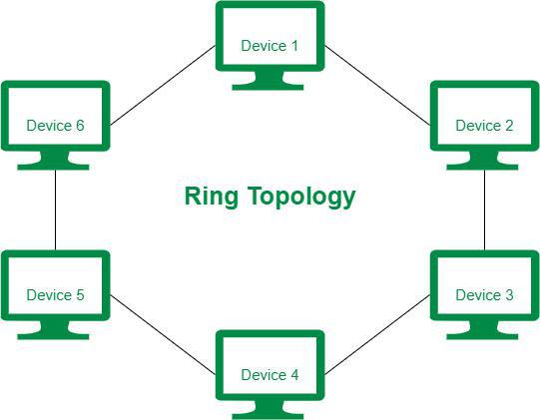
Ring Topology
In ring topology computer device are connected in a circular fashion with one another to from a ring. In this network the first device and the last device are connected to form a ring. No central server is needed in this topology.
Fig3: Ring Topology

Slide 10
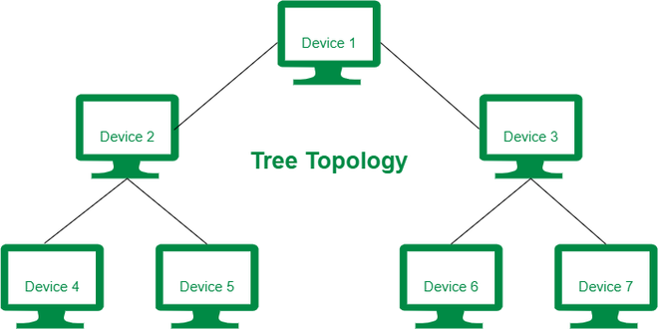
Tree Topology
In Tree topology, the network nodes are connected like branches of a tree. In this topology, different levels of computer devices are connected with a central host computer or a server.
Fig4: Tree Topology

Slide 11
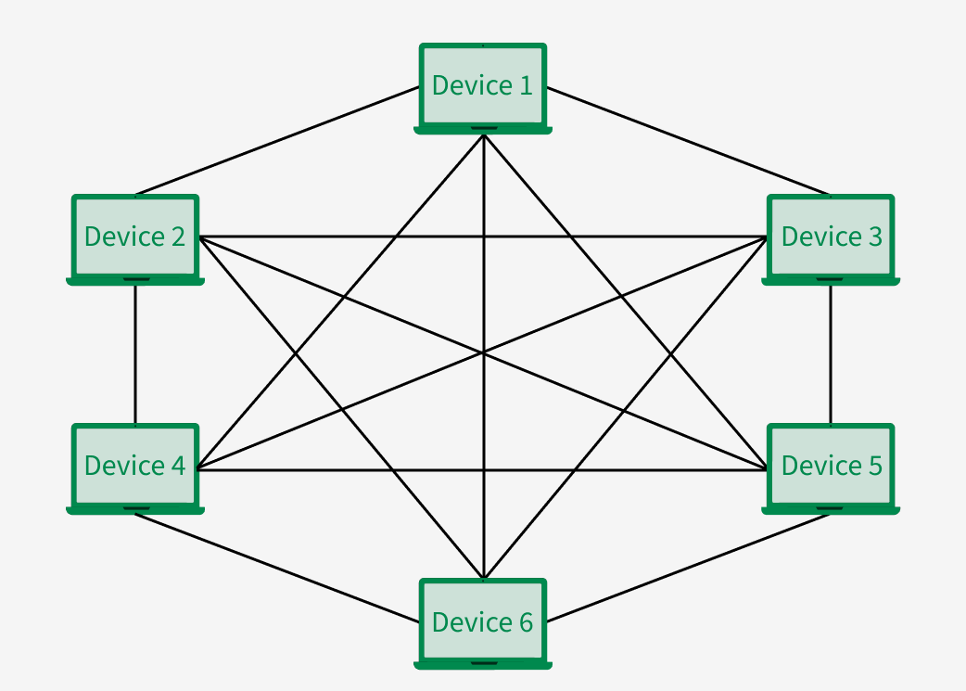
Mesh Topology
In Mesh Topology, every device in the network is directly connected to every other device in the network. This connection between the computer is called peer to peer link. This system does not need a centralized server computer.
Fig5: Mash Topology

Slide 12
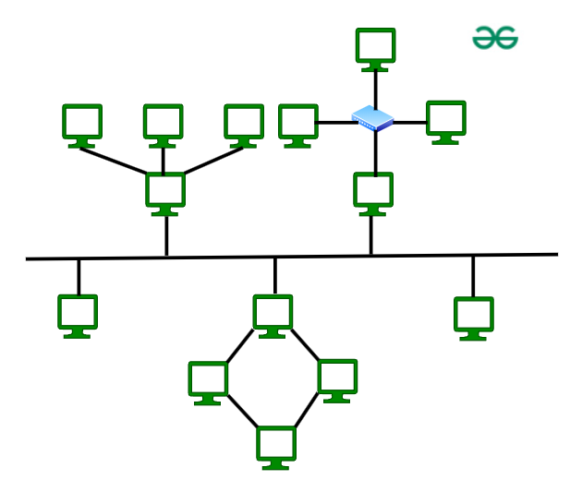
Hybrid Topology
Hybrid topology accompanies star, ring, mash and bus topology. This is used when for some particular needs one topology does not meet all of the requirement.
Fig6: Hybrid Topology

Slide 13
THANK YOU
CCE
International Islamic university Chittagong

